Slide 1

Customer Shopping Behavior Analysis
Project report — 3,900 purchase records. Insights for marketing, product strategy, retention.

Slide 2
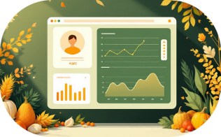

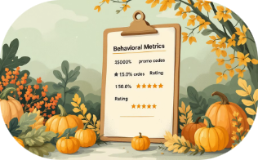
Dataset Overview
Customer Demographics
Purchase Info
Behavior Indicators
Product · Category · Amount · Season · Size · Color
Discount applied · Promo code · Shipping type · Review rating (37 missing)
Age · Gender · Location · Subscription status

Slide 3
Data Preprocessing & Exploration
Initial Checks
Missing Values
Standardization
Feature Eng.
Loaded with pandas · .info() & .describe()
37 missing ratings → imputed by product-category median
Columns converted to snake_case
age_groups · purchase_frequency_days
Cleaning Decisions
Integration
Removed promo_code_used (overlaps with discount)
Cleaned DataFrame imported to PostgreSQL

Slide 4
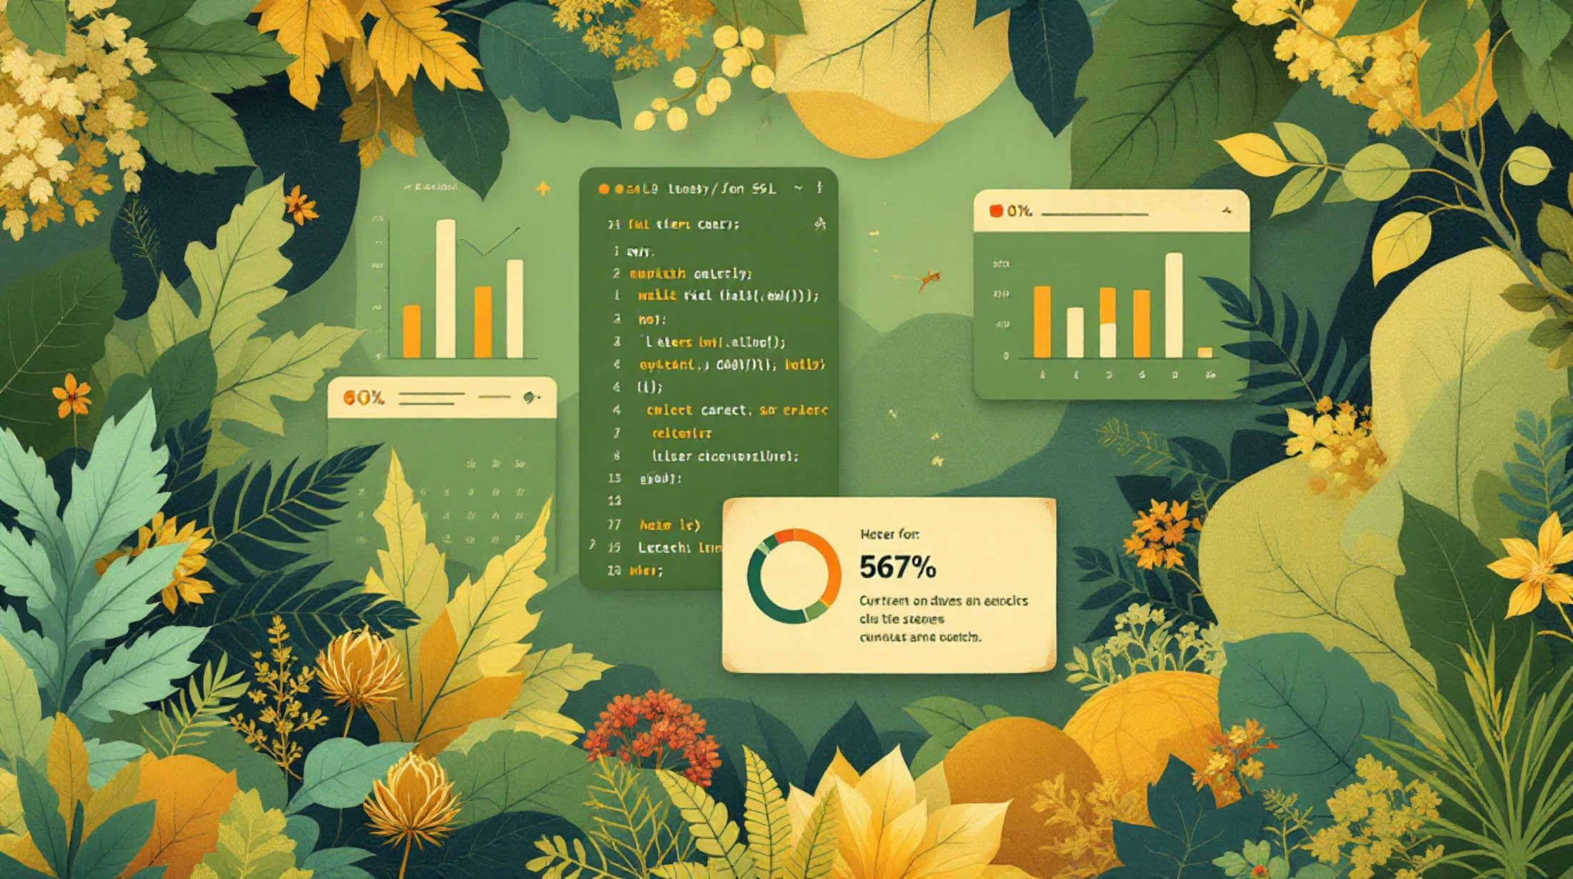
SQL Analysis — Key Queries
Revenue by Gender
Compare male vs female contribution
High-Spend Discount Users
Discount users spending above average
Top Rated Products
Gloves, Sandals, Boots, Hats, Skirts
Shipping Analysis
Express orders → slightly higher AOV

Slide 5
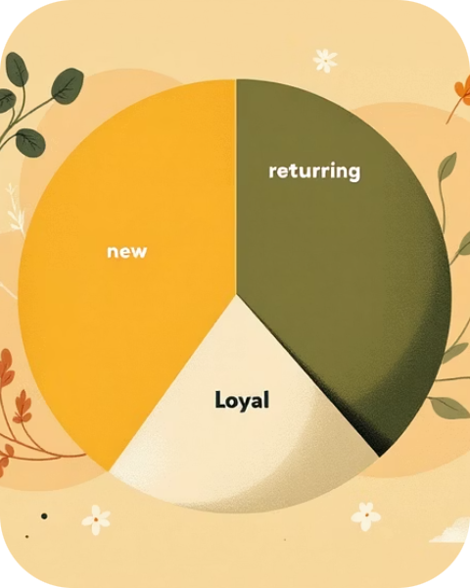


Segmentation & Product Insights
Customer Segments
Top Products
Discount-Driven Items
New · Returning · Loyal — Loyal dominate dataset
Top-5 highest-rated: Gloves, Sandals, Boots, Hats, Skirts
High discount use: Hats, Sneakers — review margin impact

Slide 6

Behavioral Patterns
01
Repeat Purchases vs Subscription
Customers with >5 purchases → tendency to subscribe (Yes/No counts)
02
Subscribers vs Non-Subscribers
Non-subscribers larger in count; subscribers show similar average spend
03
Revenue by Age
Young Adults = highest revenue share; target accordingly

Slide 7
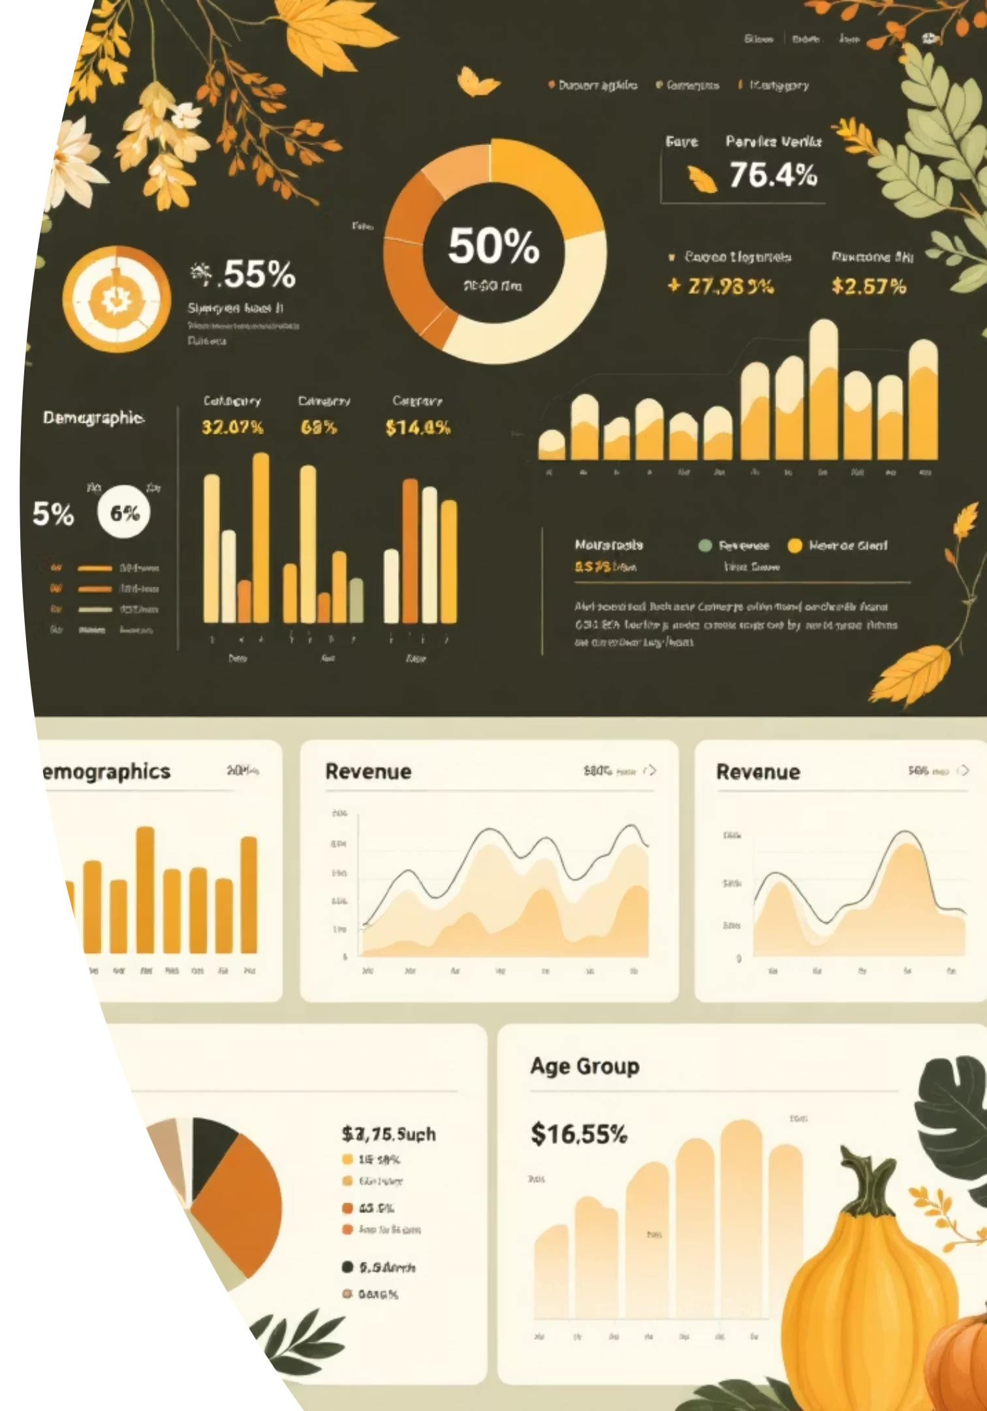
Power BI Dashboard
Visuals: demographics · subscription distribution · revenue by category · age-group sales · avg purchase · ratings

Slide 8

Business Recommendations
Strengthen Subscriptions
Enhance Loyalty
Adjust Discount Strategy
Promote Top Products
Tiered rewards · Cashback for repeat purchases
Exclusive discounts · Early access · Personalized suggestions
Review high-discount products to protect margins
Highlight high-rated, best-selling items in campaigns
Age-Based Targeting
Express Shipping Offers
Target Young Adults & Middle-aged with category-specific ads
Bundle express options — higher AOV potential

Slide 9

Impact & Next Steps
Key Wins
Next Steps
Cleaned multi-feature dataset · SQL insights · Power BI dashboard
Test subscription incentives A/B
Optimize discounting on flagged products
Deploy targeted campaigns for high-value age groups

Slide 10



Conclusion
Summary
Data analytics (Python, SQL, Power BI) enabled actionable retail strategies to boost retention, promotion, and revenue.

